Slide 1

Problem Statement:
LoRa Technology Enable Secure and Energy Efficient Smart Parking System
Team Members: ​
Aditya Shukla 19EARCS007
Anshika Gupta 19EARCS017
Sumant Kumar 19EARCS755​
Vishal Sharma 19EARCS762​
Shivani Yadav 19EARCS752​​
Under the Guidance of:
Dr. Ashok Kumar Kajla

Slide 2
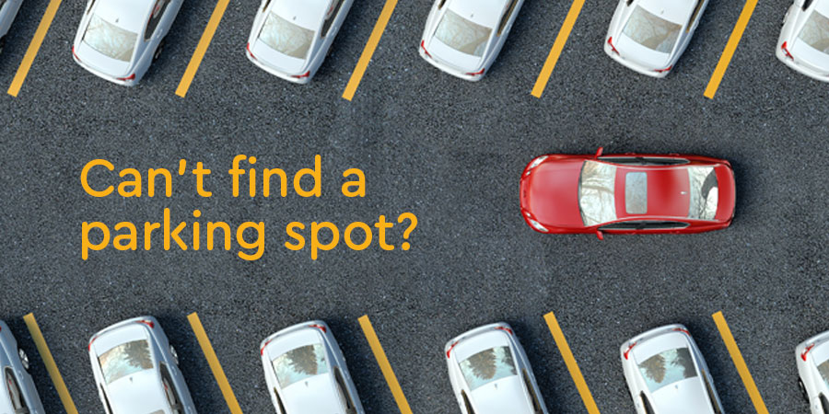
Problem Statement :
In the modern society, there is an ever-increasing number of vehicles. This is leading to problems such as large urban parking lots becoming inefficient, increasing difficulty to find open spaces in busy parking lots, as well as the increasing need to devote larger areas of land for additional parking spaces.

Slide 3
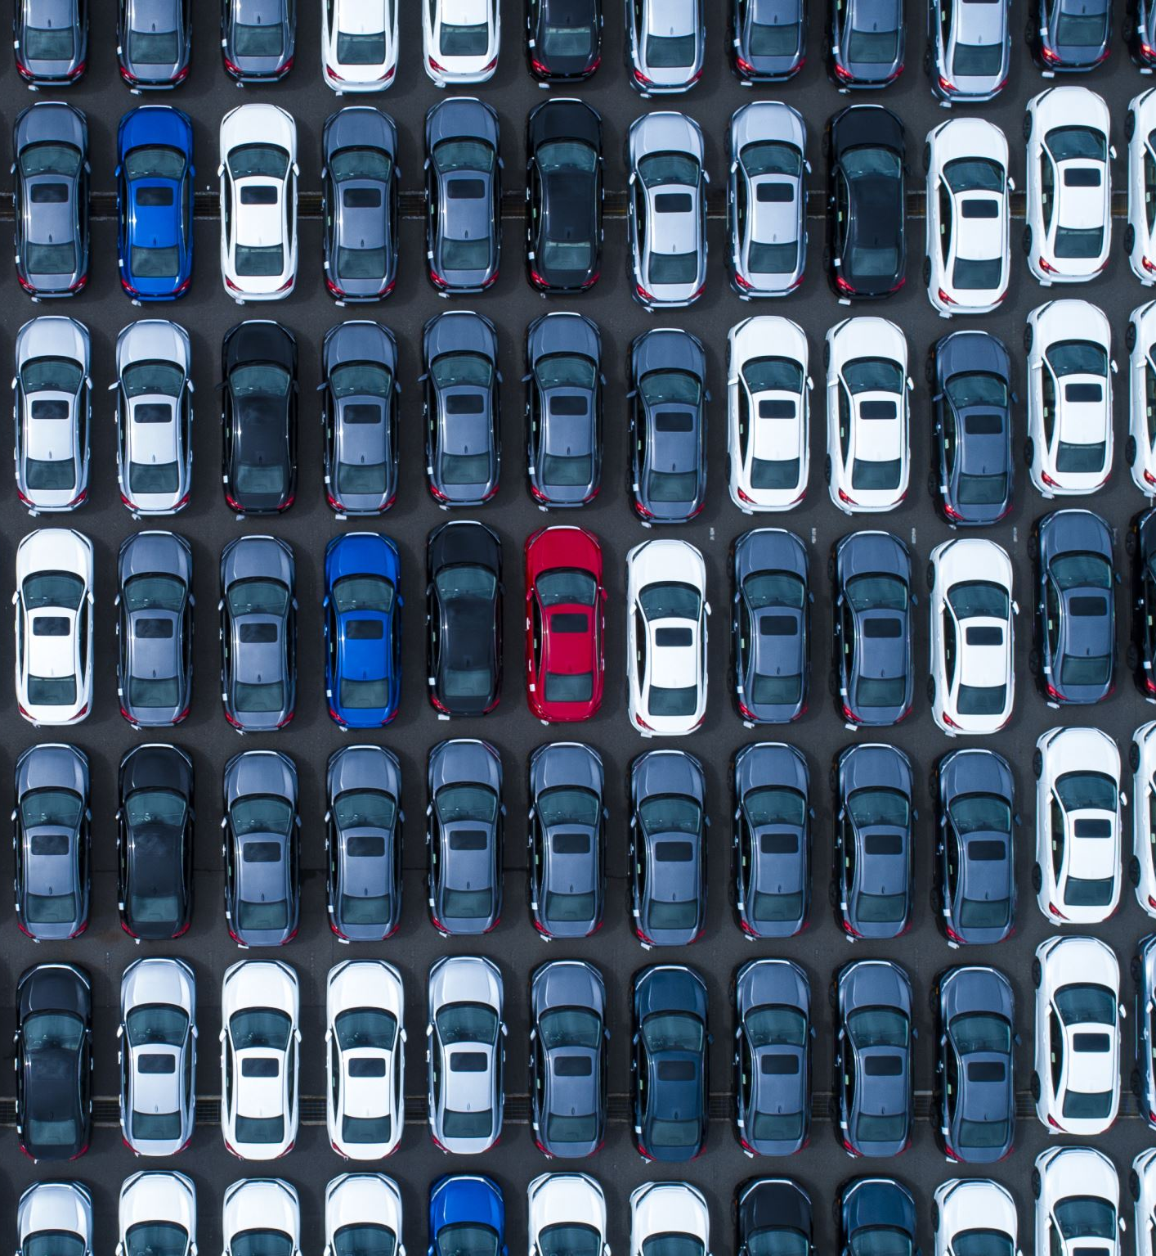
Introduction:
A smart parking system is an advanced parking management solution that leverages modern technologies to provide an efficient and automated parking experience using LoRa.
With a smart parking system, drivers can use mobile apps, websites to search for available parking spaces, book them in advance, and even pay for parking electronically. The system can also help reduce congestion and improve traffic flow by directing drivers to available parking spaces.

Slide 4
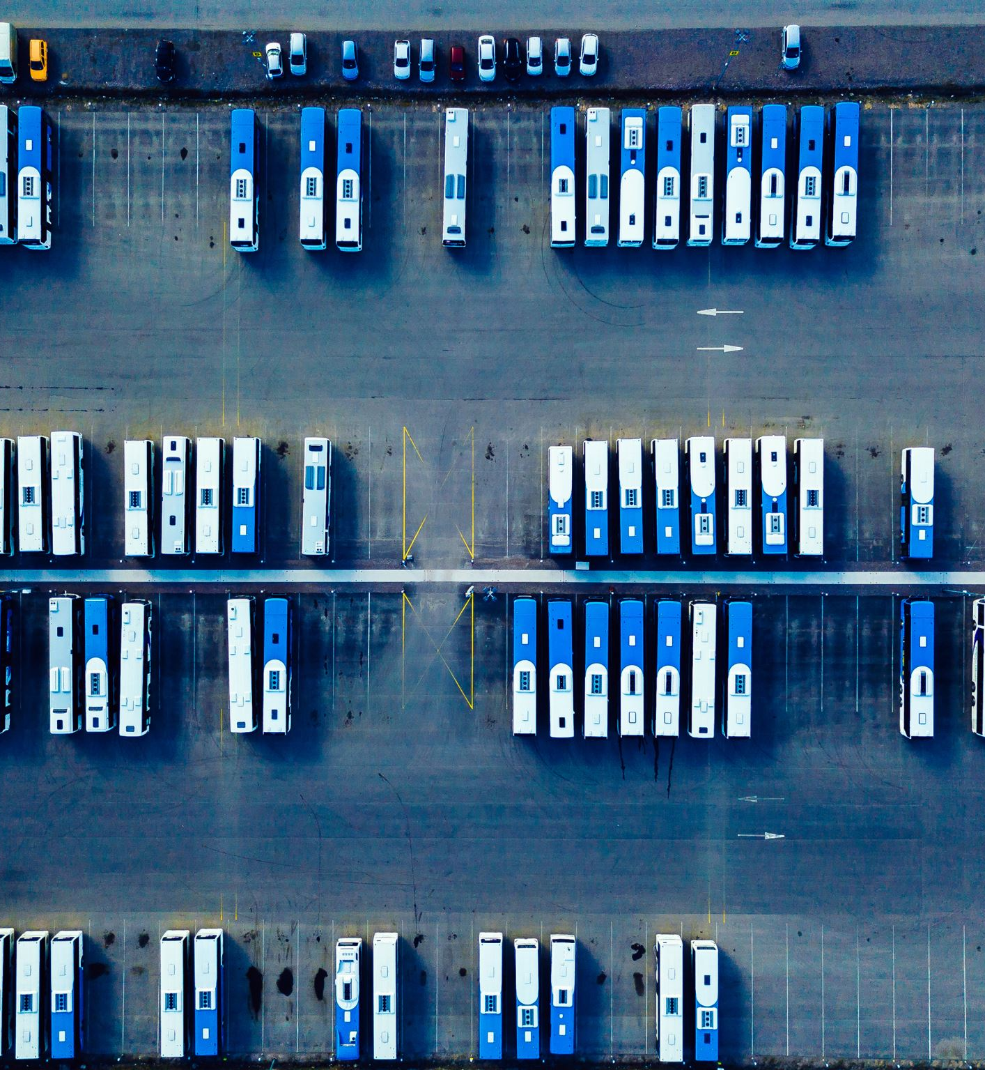
Motivation:
The motivation behind the invention of smart parking systems was to address the growing problem of traffic congestion and the inefficient use of parking spaces in urban areas.
As cities and towns grew, more people began to own cars, and finding parking spaces became increasingly difficult. Traditional parking systems were not able to keep up with the demand for parking, which led to frustration, wasted time, and increased traffic on the roads as drivers searched for available spots.

Slide 5
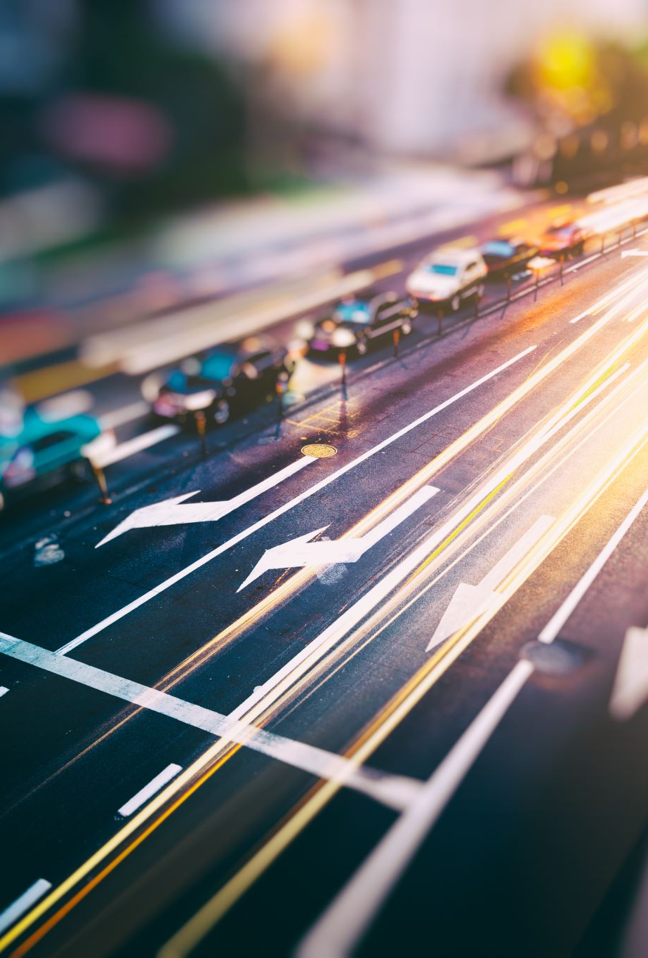
Why LoRa?
Low power consumption for duration and minimal maintenance
High data capacity for managing multiple parking areas
Bi-directional communication with end-to-end encryption to protect your data
Wireless range of up to 3 km (1.86 miles) in urban areas or indoors and 15 km (9.32 miles) in rural areas or outdoors

Slide 6
Real time survey :

Slide 7
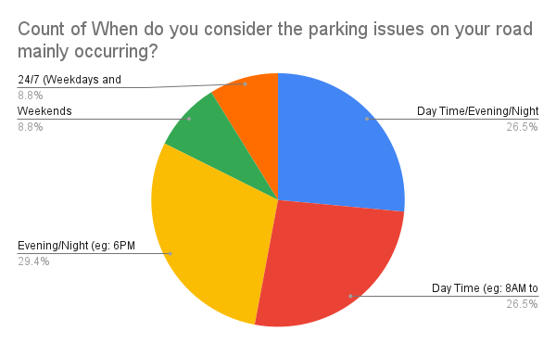

Slide 8
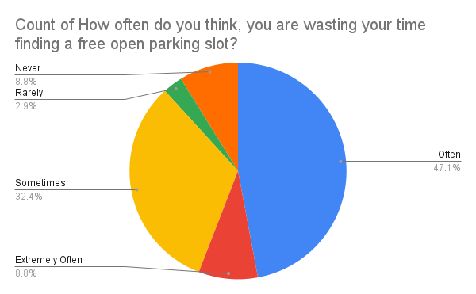

Slide 9
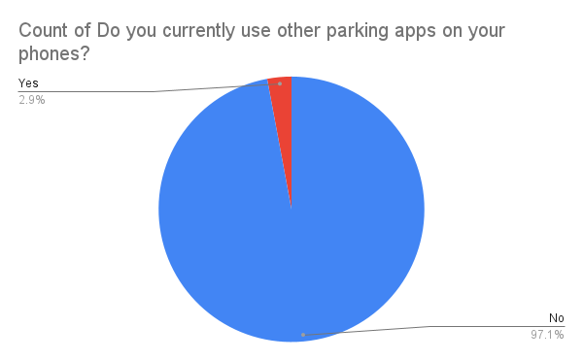

Slide 10


Feature Comparision:
Existing Solutions | Park+ | Get My Parking | Secure Parking | Parking Rhino | Park Smart | Park Zap | ValetEZ | VersionX | Our Solution
Advance Booking
FASTag
Future Prediction
Monthly Pass
2 Wheelers Parking
Electric Vehicles Charging
Flexible cost

Slide 11
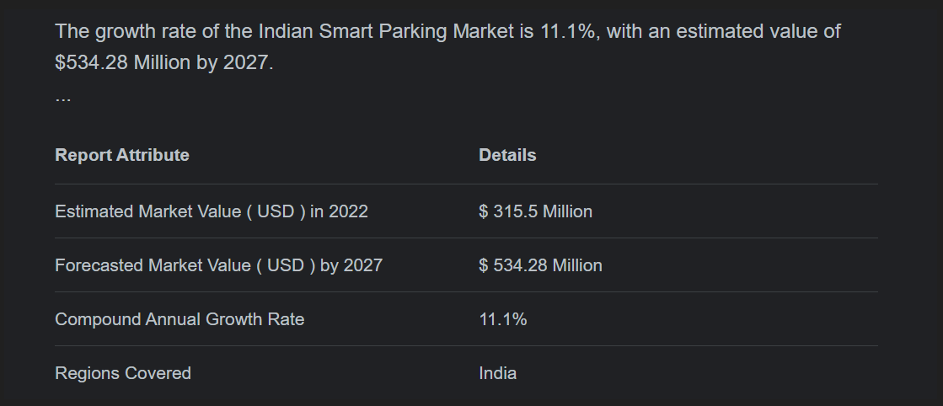

Slide 12
Detailed Solution:
We will make a platform where the user will get all the information related to availability of parking slots.
A picture of parking infrastructure in real time
Security and transparency in parking fees and service delivery
Managing and obtaining parking spots with flexibility
Parking usage data analytics

Slide 13
User ID removed
Start Application
Features
Real time data Display
Booking Slot
Advance Booking
Vehicle Category
Select Slot
Slot Allotted
Cloud Database
User ID generated
Time Started
Time out
Make payment

Slide 14
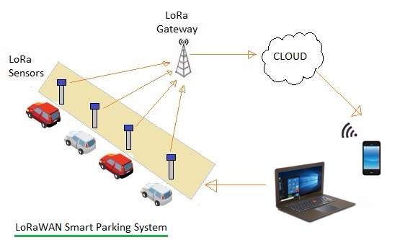
Detailed System:

Slide 15
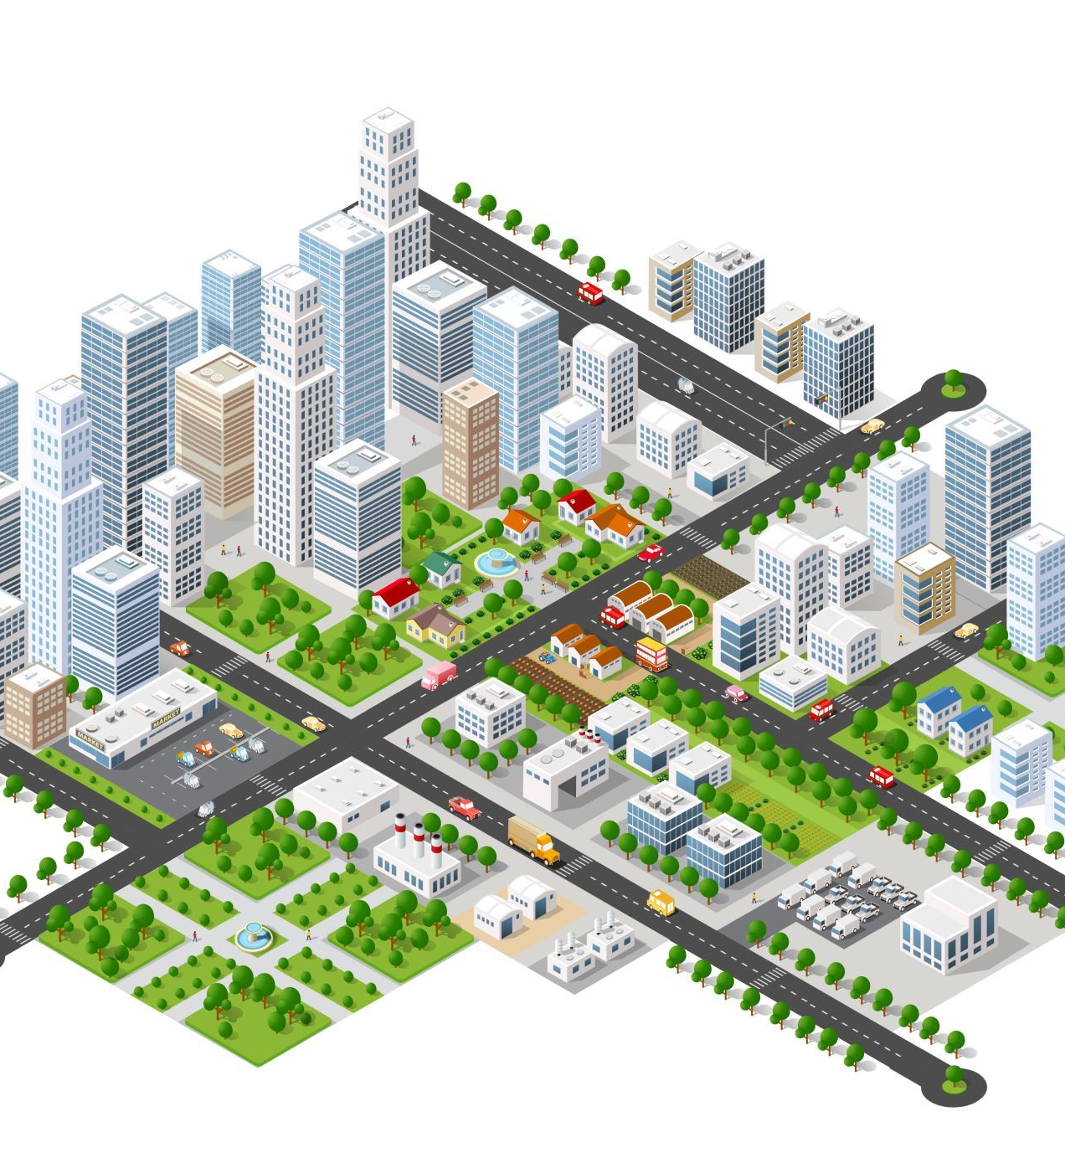
Target Audiences:
Corporate Parking
Malls/Hotels
Societies/ Colonies
Spiritual Destinations

Slide 16
Technology Used:
LoRa gateways: LoRa gateways are the backbone of the system and are used to receive and transmit data between the sensors and the cloud server.
LoRa Technology: LoRa Technology(EMI sensor, ParkMOD sensor) are small devices that are placed in parking spaces to detect whether the space is occupied or vacant.
Cloud server: The cloud server is the central hub that processes and analyzes the data received from the gateways and sensors.

Slide 17
Mobile application: The mobile application is used by drivers to find and reserve parking spaces
Backend software: The backend software is used to manage and monitor the system, including the gateways, sensors, cloud server, and mobile application.

Slide 18
Financial Feasibility:
LoRaWAN | 20,000
Hardware Kit | 25,000
Server | 25,000
Playstore Console | 2200
Domain | 2000
Operations | 25,000
Marketing & Sales | 50,000
Total | 1,49,200

Slide 19
Future Enhancement:
Dynamic pricing: Smart parking systems could use real-time data to adjust parking prices based on demand, encouraging drivers to park in less busy areas and reducing congestion in popular areas.
Predictive parking: By analyzing historical parking data, smart parking systems could predict when and where parking demand will be highest, allowing drivers to plan their trips accordingly and reducing the time spent searching for a parking spot.
Integration with smart cities: Smart parking systems could be integrated with other smart city technologies, such as traffic management systems and public safety systems, to improve overall city efficiency and livability.
Electric vehicle charging: Smart parking systems could be equipped with electric vehicle charging stations, allowing drivers to conveniently charge their electric vehicles while parked.

Slide 20
Revenue Model:
Parking fees
Advertising
Data analytics
Additional Services

Slide 21
Parking fees: The primary revenue stream for a smart parking system is typically parking fees charged to drivers. The system can use real-time data on parking availability and occupancy to optimize pricing and increase revenue.
Advertising: Smart parking systems can also generate revenue through advertising. For example, the system can display targeted ads on the mobile application or digital signage in the parking lot.
Data analytics: Smart parking systems can also generate revenue by selling data analytics to third-party companies. The system can provide real-time data on parking usage, traffic patterns, and other insights that can be valuable to companies such as urban planners and transportation agencies
Additional services: the system can provide car washing or electric vehicle charging services to drivers while they park. These additional services can be a source of revenue for the parking lot operator and can enhance the overall parking experience for drivers.

Slide 22
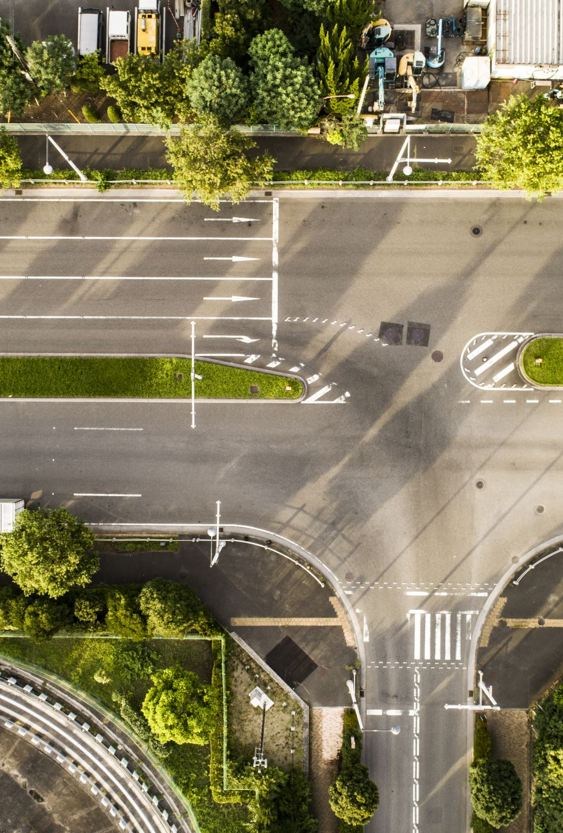
Conclusion:
The conclusion of the project for smart parking using LoRa(Long Range Low Power Consumption) is that it is a cost-effective and efficient way to manage parking in densely populated areas.
The proposed architecture for a parking detection system would take less searching time for the empty spaces and reduce difficulty of single cars with no proper parking across two spaces.

Slide 23
References:
https://www.academia.edu/44359965/IRJET_Smart_Parking_using_LoRa
https://ieeexplore.ieee.org/document/8644697
https://issuu.com/irjet/docs/irjet-v7i9259
https://www.researchgate.net/publication/321824521_Analyzing_LoRa_a_Use_Case_Perspective
https://www.sciencedirect.com/science/article/pii/S2095809917306057

Slide 24
Thank you

